Slide 1
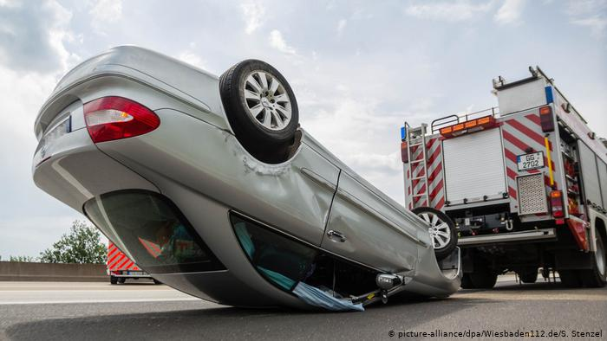

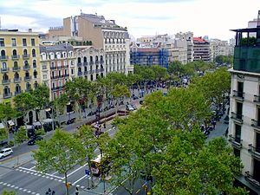

Slide 2
TABLE OF CONTENTS
Introduction
Objectives
Conceptual Framework
Descriptive analysis
Research questions
Findings
Conclusions
Recommendations
Appendix

Slide 3
INTRODUCTION
BARCELONA CAR ACCIDENT 2017
More people living and working in an area means people driving to and from the workplace thus congested traffic. In Barcelona Spain the total number of reported accidents in 2017 as the dataset provided by the lecturer was 10339.My analysis aims at finding out the Locations and time When most accidents happen and provide relevant insights.
Description of the dataset: 10339 observations and 15 variables.
The dataset had 27 missing values equivalent to 0.02% of the total Observations.

Slide 4
OBJECTIVES
To find out the districts and streets with most victims in Barcelona.
To know which part of the day, weekday, hour and month with the most accidents.
To know the major causes of these accidents.
To come up with insights that can be implemented to reduce the number of accidents.

Slide 5
METHODOLOGY
Used SAS 9.4 Statistical software for the Analysis.
I used Proc Import, Proc Contents, Proc Print, Proc Sort, Proc Means, Proc Freq, Proc Format, Proc SQL, Proc Univariate, Proc SGPLOT, Proc Reg, Proc Anova, Proc Corr, Proc Gchart, Proc Summary and proc tabulate to analyze my findings.
Dropped 27 missing observations Checked for Outliers.
Generate new features.
Performed data transformation.
Dropped id column.

Slide 6
CONCEPTUAL FRAMEWORK
District Name ,Neighbourhood Name and street are categorical character variables.
(LOCATION-CATEGORICAL)
Hour ,part of the day, day ,weekday and month are categorical numeric variables.
(TIME-CATEGORICAL)
Mild injuries ,serious injuries, vehicles involved ,Longitude and latitude are continuous numeric variables.
(CONTINUOUS)

Slide 7
DESCRIPTIVE ANALYSIS
Variable | N | N Miss | Minimum | Maximum | Mean | Median | Std Dev
Day Hour Mild_injuries Serious_injuries Victims Vehicles_involved Longitude Latitude | 10339 10339 10339 10339 10339 10339 10339 10339 | 0 0 0 0 0 0 0 0 | 1.00 0.00 0.00 0.00 0.00 0.00 2.09 41.32 | 31.00 23.00 10.00 4.00 10.00 14.00 2.22 41.47 | 15.78 13.81 1.15 0.02 1.18 1.92 2.16 41.40 | 16.00 14.00 1.00 0.00 1.00 2.00 2.16 41.40 | 8.76 5.32 0.74 0.16 0.74 0.71 0.02 0.02
The total number of observations was 10339.
27 unknown districts were dropped bringing the total number of observations to 10312 .
No missing values on numeric continuous variables.
The maximum serious injuries was 4 ,maximum vehicles involved 14 and maximum victims 10.

Slide 8
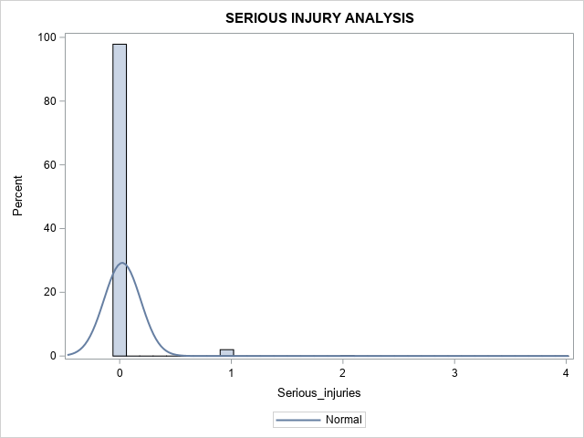
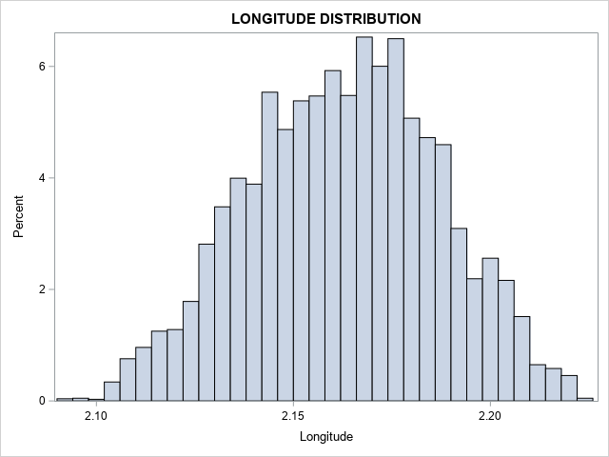
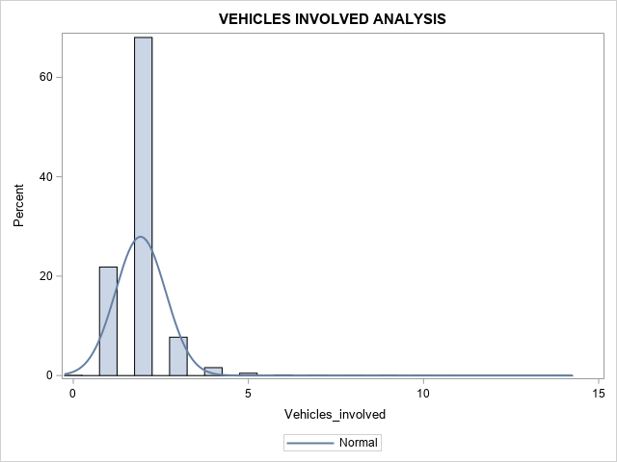
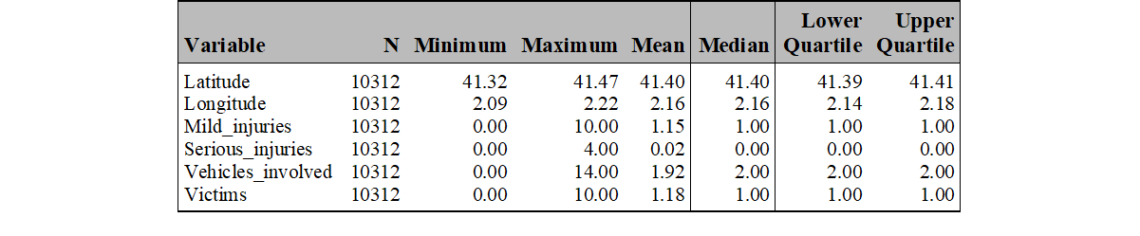
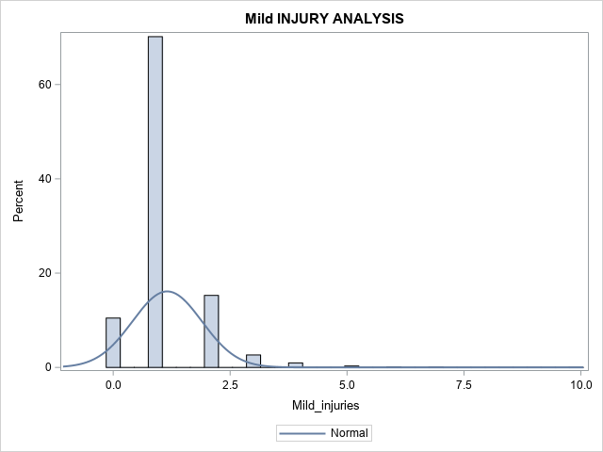
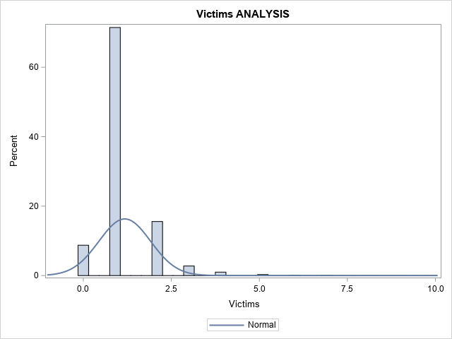
DESCRIPTIVE ANALYSIS
Outliers were checked and droped

Slide 9
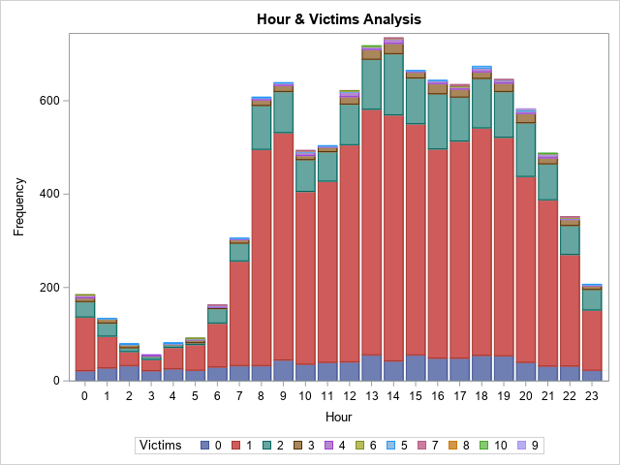
DESCRIPTIVE ANALYSIS
Most accidents happen between 8am-9am,13pm-14pm and 15pm-19pm.

Slide 10
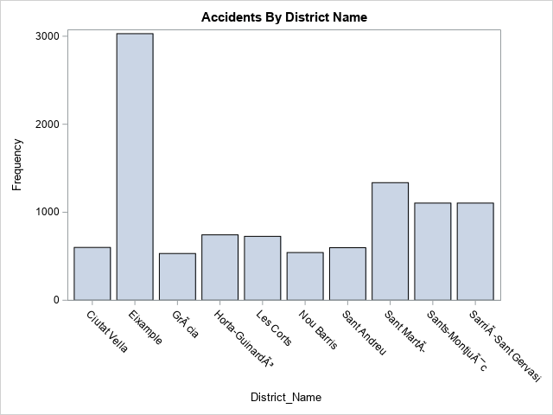
DESCRIPTIVE ANALYSIS
District_Name | victims_desc
Eixample | 3562
Sant MartÃ­ | 1645
Sants-MontjuÃ¯c | 1329
SarriÃ -Sant Gervasi | 1290
Les Corts | 894
Horta-GuinardÃ³ | 839
Sant Andreu | 704
Nou Barris | 661
Ciutat Vella | 634
GrÃ cia | 588
The district with the highest number of car accidents is Eixample with 29.37 of the total accidents followed by Sant MartÃ­,Sants-MontjuÃ¯c and SarriÃ -Sant Gervasi

Slide 11
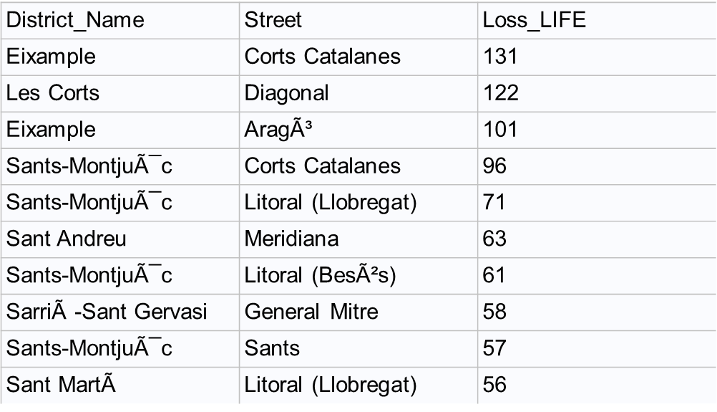
DESCRIPTIVE ANALYSIS
District_Name | Neighborhood Name | DEATHS
Eixample | la Dreta de l'Eixample | 1368
Eixample | l'Antiga Esquerra de l'Eixample | 680
Eixample | la Sagrada FamÃ­lia | 457
Eixample | la Nova Esquerra de l'Eixample | 454
SarriÃ -Sant Gervasi | Sant Gervasi – Galvany | 446
Les Corts | les Corts | 385
Eixample | el Fort Pienc | 319
Sants-MontjuÃ¯c | la Marina del Prat Vermell | 304
Sants-MontjuÃ¯c | el Poble-sec | 291
Eixample | Sant Antoni | 284
la Dreta de l'Eixample is the most central of the Barcelona Eixample neighbourhood with highest concentration of modern structure.

Slide 12
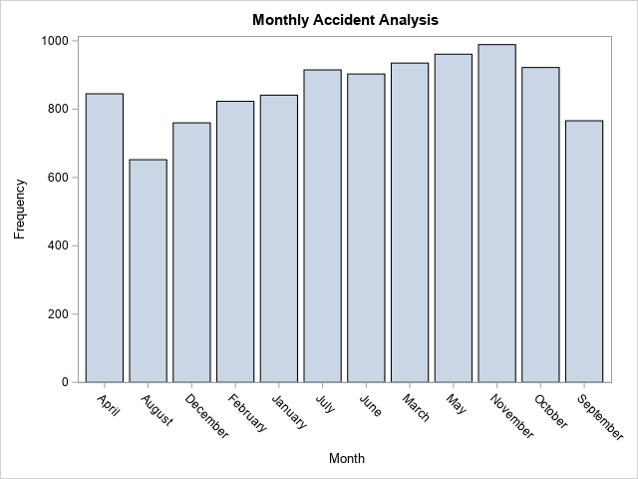
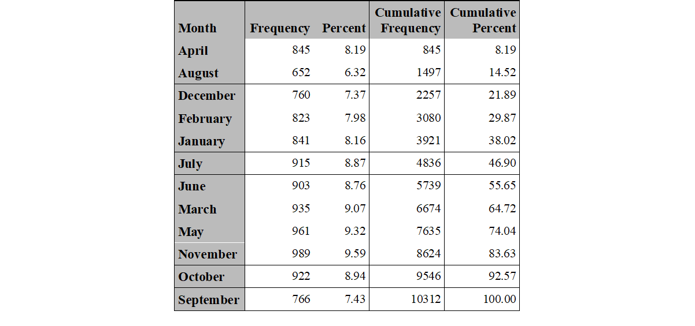
DESCRIPTIVE ANALYSIS
November had the most number of car accidents with 989.thelowest was August with 652 accidents

Slide 13
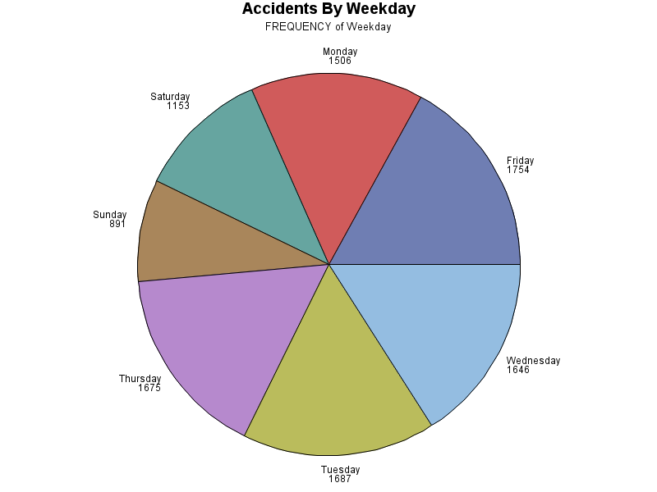
DESCRIPTIVE ANALYSIS
Friday had the highest number of vehicle accidents with 17.54% and Sunday the lowest with 8.64% of the total accidents.
Phi coefficient is positive therefore the two variables are associated

Slide 14
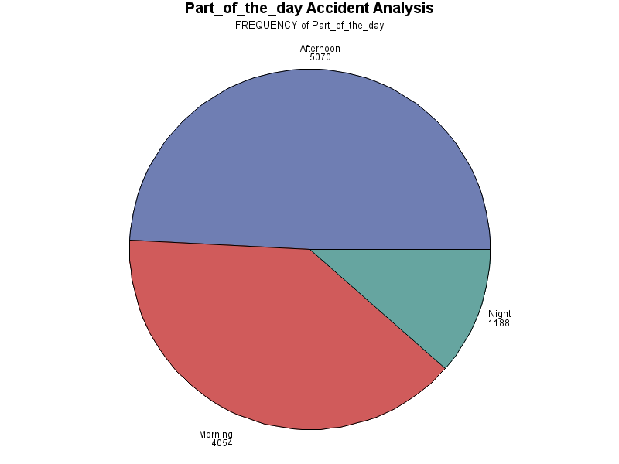

DESCRIPTIVE ANALYSIS
Afternoon had the highest number of victims with 49% of the total accidents , followed by morning with 39.31% and night with 11.52%

Slide 15
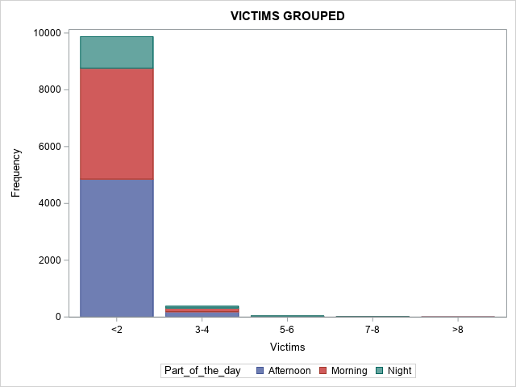
DESCRIPTIVE ANALYSIS
Victims involved by Part of the day
Most victims were less than 2 and more accidents in the afternoon.

Slide 16
PROJECT FOCUS
KEY BUSINESS QUESTIONS
Which district, neighbourhood, street had the highest vehicle accidents?
Which hour, part of the day, day, weekday, month do most accidents happen in Barcelona?
Is there any association between weekday and part of the day?
Is there any relationship between the number of vehicles involved and the Victims?

Slide 17
PROC UNIVARIATE PROCEDURE FOR VICTIMS
Pvalue(<.0001)No significance difference in the means of victims.

Slide 18
CORRELATION ANALYSIS
VICTIMS AND SERIOUS INJURIES
Pearson correlation between victims and serious injuries is 0.07,which is not significant with a p value of <.0001 indicating a weak relationship between the two variables.
VICTIMS AND MILD INJURIES
Pearson correlation between victims and mild injuries is 0.97,which is significant with a p value of <0.0001.this indicates a strong linear positive relationship between the two variables.

Slide 19
T-TEST STATISTICS
Students t distribution is used to determine if there is significant between the means of two groups which may be related in certain features. I used one sample test to compare sample mean with the mean of population.

Slide 20
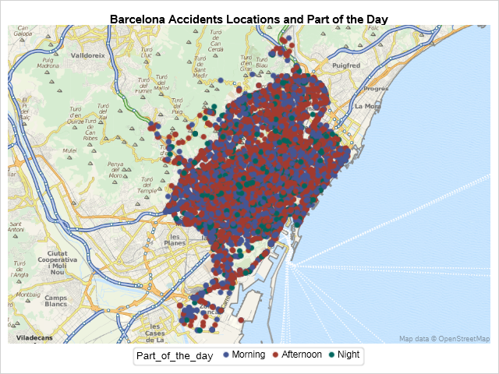
SGMAP PROCEDURE FOR PART OF THE DAY
The density scatter plot for the latitude and longitude vs part of the day shows a liner tread.

Slide 21
LINEAR REGRESSION MODEL
R Square of 0.0247 shows no linear relationship between the vehicles involved and the number of victims.

Slide 22
CONCLUSION
Eixample district have the highest number of accidents.
Majority of la Dreta de l'Eixample neighbourhood belong to upper class of Barcelona with large selection of vacation destinations and high population.
Most of the accidents happen in the Afternoon and in the morning.
Friday has the highest number of accidents and Sunday the lowest.
The month with the highest number of accidents is November and the one with lowest is August.
No linear relationship between the number of vehicles involved and Victims.

Slide 23
RECOMMENDATIONS
The government of Barcelona should limit the speed of motorists.
Road expansion.
Install more speed cameras and traffic lights.
The drivers to keep an eye on the road and avoid distractions.
Implementing other prediction models for better results.

Slide 24
THANK YOU
2020-06-03

